Slide 1
Yelp Recommendation System and Sentiment Analysis
Devesh kandpal
Soham Dasneogi

Slide 2
Yelp DataSet
The Yelp dataset is a subset of businesses, reviews and user data
Each file consists of a single object type, one JSON-object-per-line
Yelp aggregates review data from its users and ranks restaurants based on them

Slide 3
Goals
Using user profile, we would recommend restaurants using geospatial location in conjunction with collaborative filtering
Using the user reviews, we would performed sentimental analysis on the recommended restaurant reviews.

Slide 4
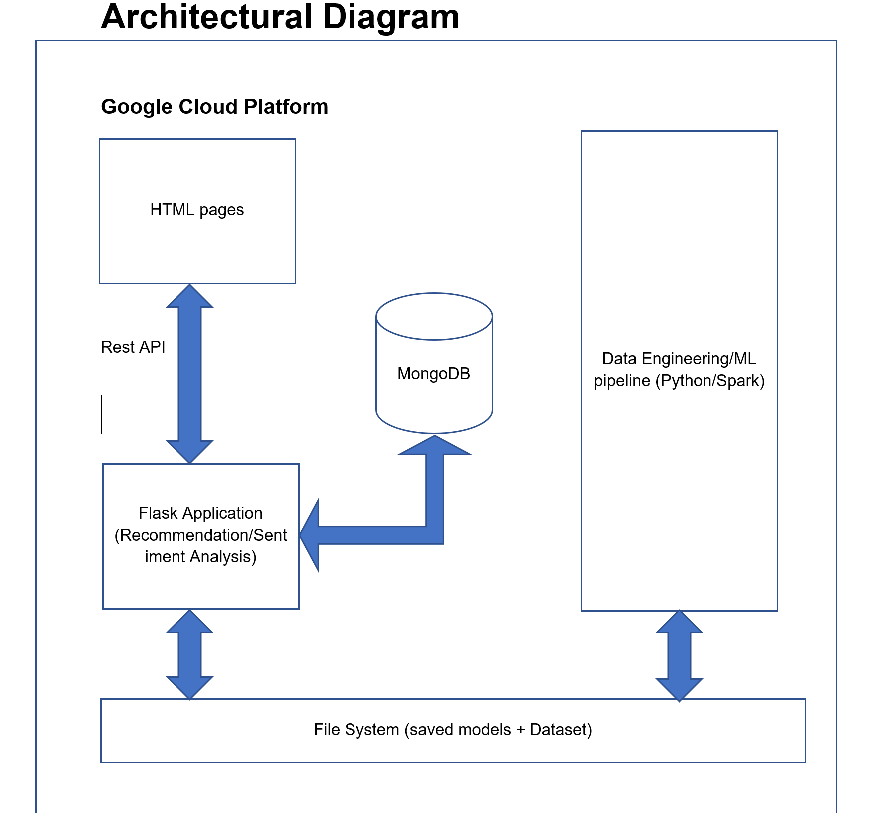
System Architecture

Slide 5
Technological stack
Apache Spark (PySpark) for data cleaning and segregation
Flask for buiding the web application
MongoDB for user and restaurant details apart from storing the results of Option Mining and Sentiment Analysis done using LDA
Spark ML for ALS Matrix Factorization Model
Genism for Topic Modeling on restaurant reviews and sentiment polarity
Google Cloud Compute for hosting the data pipeline

Slide 6
Recommender system
The two most common types of recommender systems are Content-Based and Collaborative Filtering
Collaborative Filtering produces recommendations based on the knowledge of users’ attitude to items, that is it uses the wisdom of the crowd to recommend items
Content based recommender system focus on the attributes of the items and give you recommendations based on the similarity between them

Slide 7
Collaborative filtering
Collaborative Filtering is most commonly used because it usually gives better results.
The algorithm has the ability to do feature learning i.e it can start to learn for itself what features to use for itself
Collaborative Filtering is further divided into MEMORY-BASED CF and MODEL-BASED CF

Slide 8
Model Based Collaborative Filtering
Model-Based CF is based on matrix factorization which is an unsupervised learning method for latent variable decomposition and dimensionality reduction
We are using ALTERNATING LEAST SQUARES (ALS) Matrix Factorization method
ALS works by trying to find out the optimal representation of a user and a product matrix
The genius part of ALS is that it alternates between finding the optimal values for the user matrix and the product matrix

Slide 9
Alternating LEAST Squares
The ALS modelling is an unsupervised technique and takes into consideration latent factors.
Our model is build on three features user business and reviews
We construct a Matrix Factorization model using these three features
Resulting model is capable of answering the following:
1. Products for Users
II. Users of a given Product
We evaluate the model on basis of RMSE score

Slide 10
Sentiment analysis
Sentiment Analysis is opinion mining and a process to determining whether a piece of review is POSITIVE NEGATIVE or NEUTRAL.
It is deriving the opinion of the writer.
We have used Latent Dirichlet Analysis (LDA) to mine the user reviews. The idea is to showcase the what people in the consolidated are talking about so that it gives a high level view to the business users without getting into the details of reading each review

Slide 11
Sentiment analysis

